Slide 1

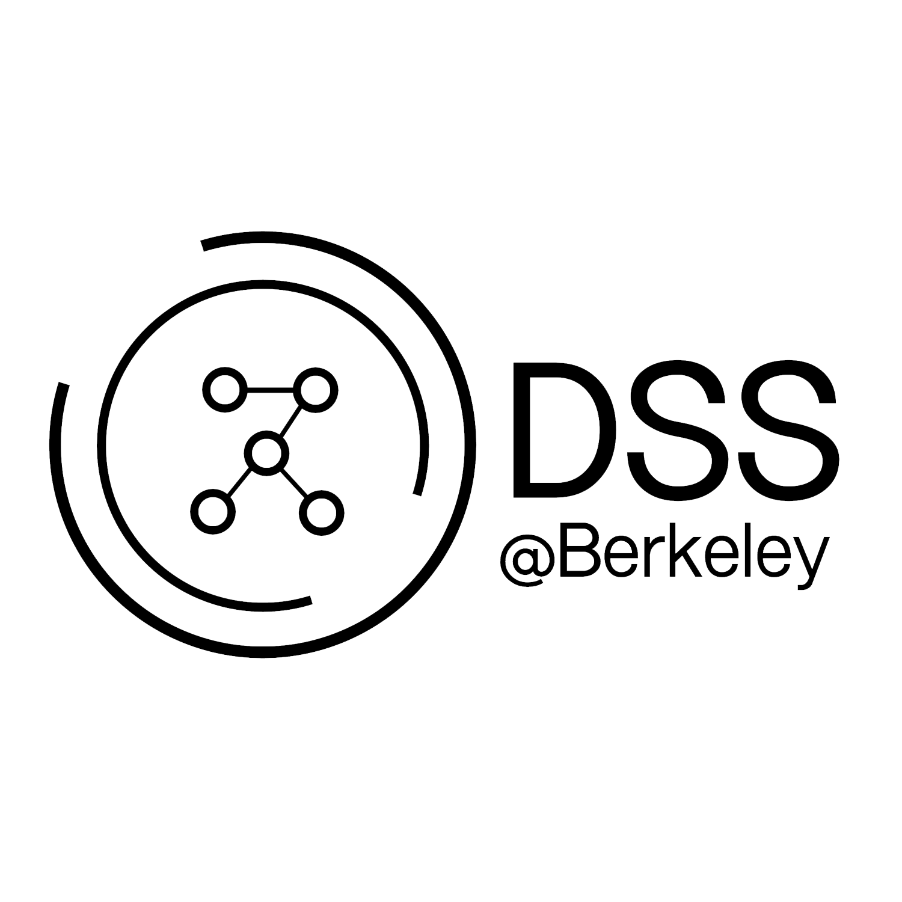
R for Data Science
Workshop Series #4

Slide 2

Data Science Society at Berkeley
Instructors + TA’s

Slide 3
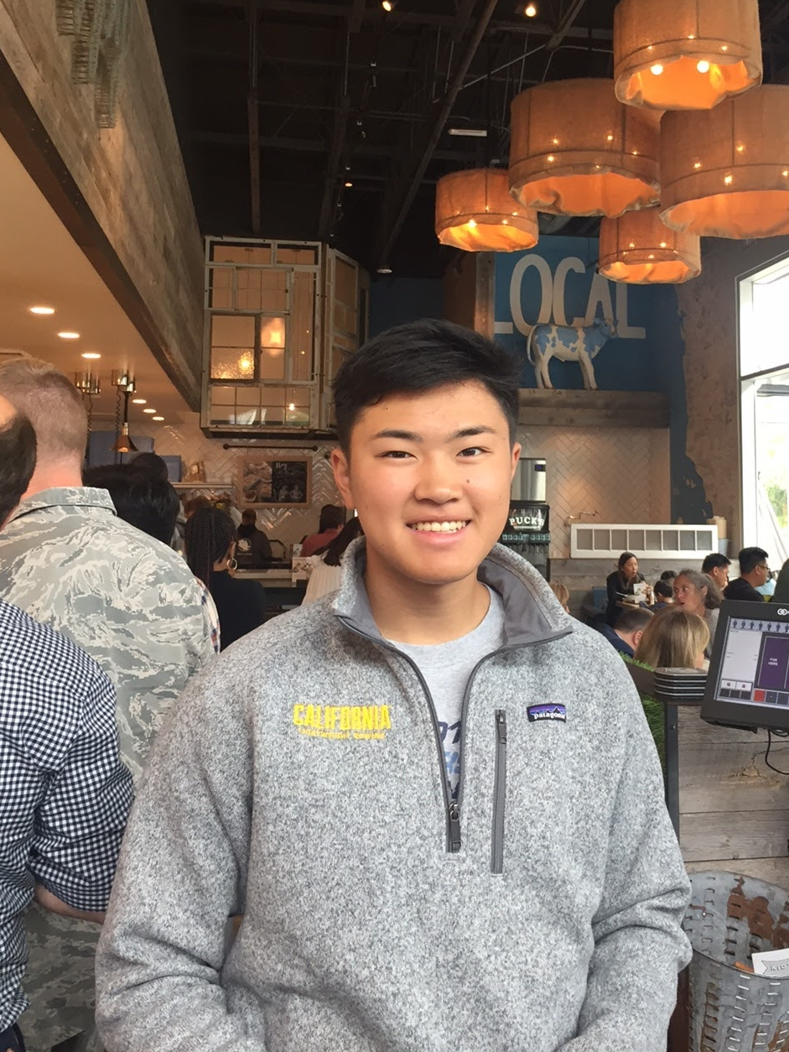
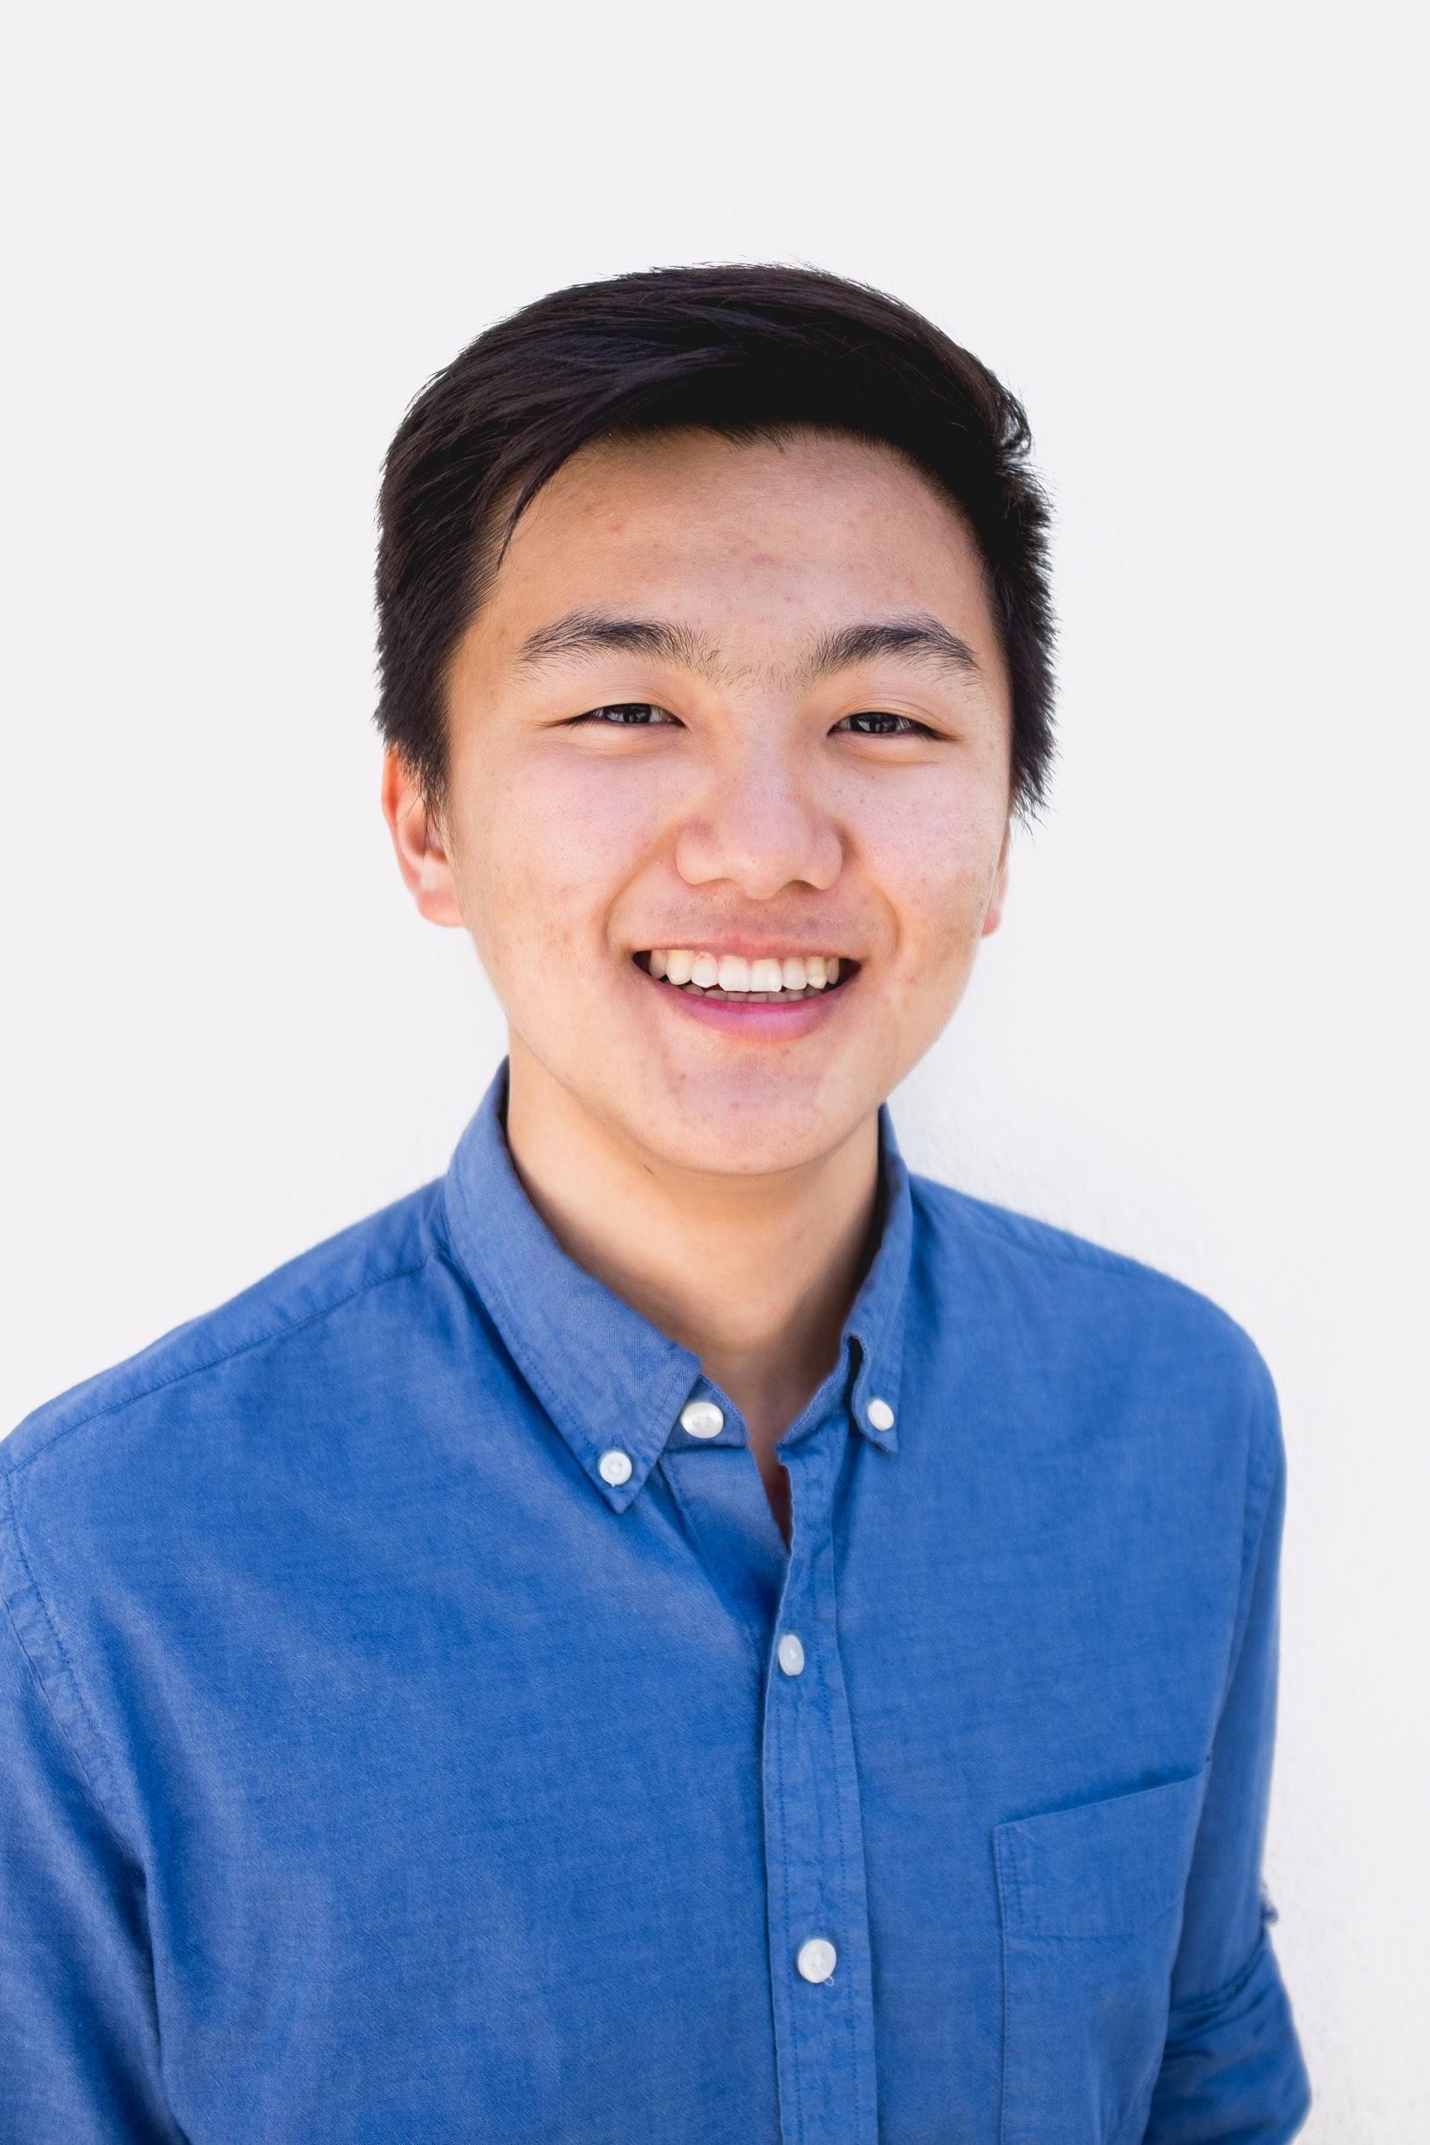
Instructors
Alex Nakagawa alex.nakagawa@berkeley.edu
Sophomore
Computer Science & Cognitive Science
Jun Seo Park
junseopark@berkeley.edu
Junior
Statistics & Economics
Notes:
Quick introductions, some interesting facts
Talk about how we got interested in data science
Encourage questions!

Slide 4
TA’s
Shalini Kunapuli
Fayyaz Ahamed
Pooja Doctor
Notes:
Quick introductions, some interesting facts
Talk about how we got interested in data science
Encourage questions!

Slide 5

Data Science Society at Berkeley
Lesson Plan

Slide 6
Lesson Plan
Overview
History of R
RStudio
Tidyverse
Using R
Basic syntax/RStudio
Vectors/Matrices/Dataframes
readr/dplyr/ggplot2
Mini-Project

Slide 7
R Workshop: 1
Overview

Slide 8
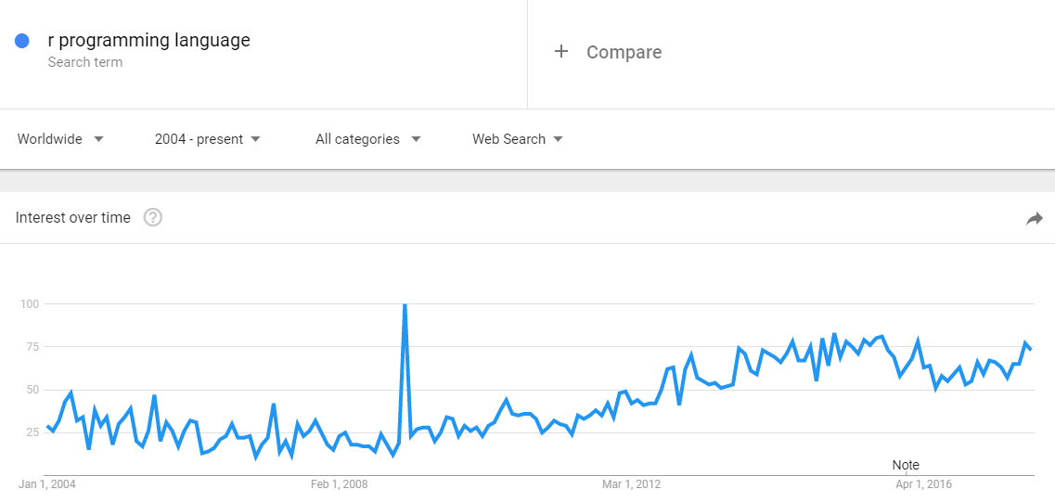
1.1 History of R
Origins in S (developed by Bell Labs)
Ported to open-source software in 1990s
Gained traction following 2008 recession for open-source, OOP, well-documented environment

Slide 9
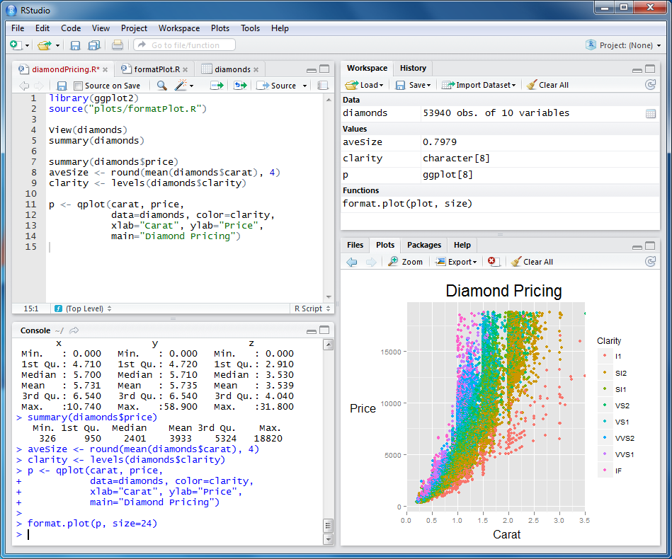
1.2 RStudio
Primary IDE for R
Built-in support for plots, packages, documentation, environment details, etc.
Build dashboards with R Markdown files

Slide 10

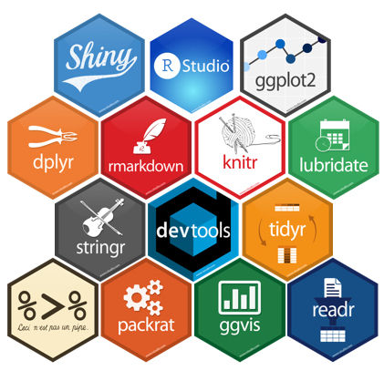
1.3 Tidyverse
Hadley Wickham
ggplot2: Plotting data
dplyr: Data manipulation
readr: Reading data files
tidyr: Create “tidy” data
Each observation is a row
Each variable is a column
shiny: Interactive data dashboards

Slide 11
R Workshop: 2
Using R!!
http://tinyurl.com/f17-dss-r

Slide 12
https://piazza.com/class/j7s01y165odq5
Data Science FAQs

